Slide 1
this is valcon

Slide 2



We are the premium operations consulting firm in Europe
  ESTABLISHED IN 2000
“
We are a consulting firm with Scandinavian roots, employed by clients worldwide to create value. Our result-oriented culture is built into our name.
Val = Value + con = consulting
  NATIONALITIES +10
”
  FOOTPRINTS IN +40 COUNTRIES
  “We aim to create a lasting impact for our clients – we call it leaving footprints”

Slide 3

STRATEGY
COMPANIES STRUGGLE WITH CONNECTING STRATEGY AND OPERATIONS
OPERATIONS
Notes:
The HOW

Slide 4
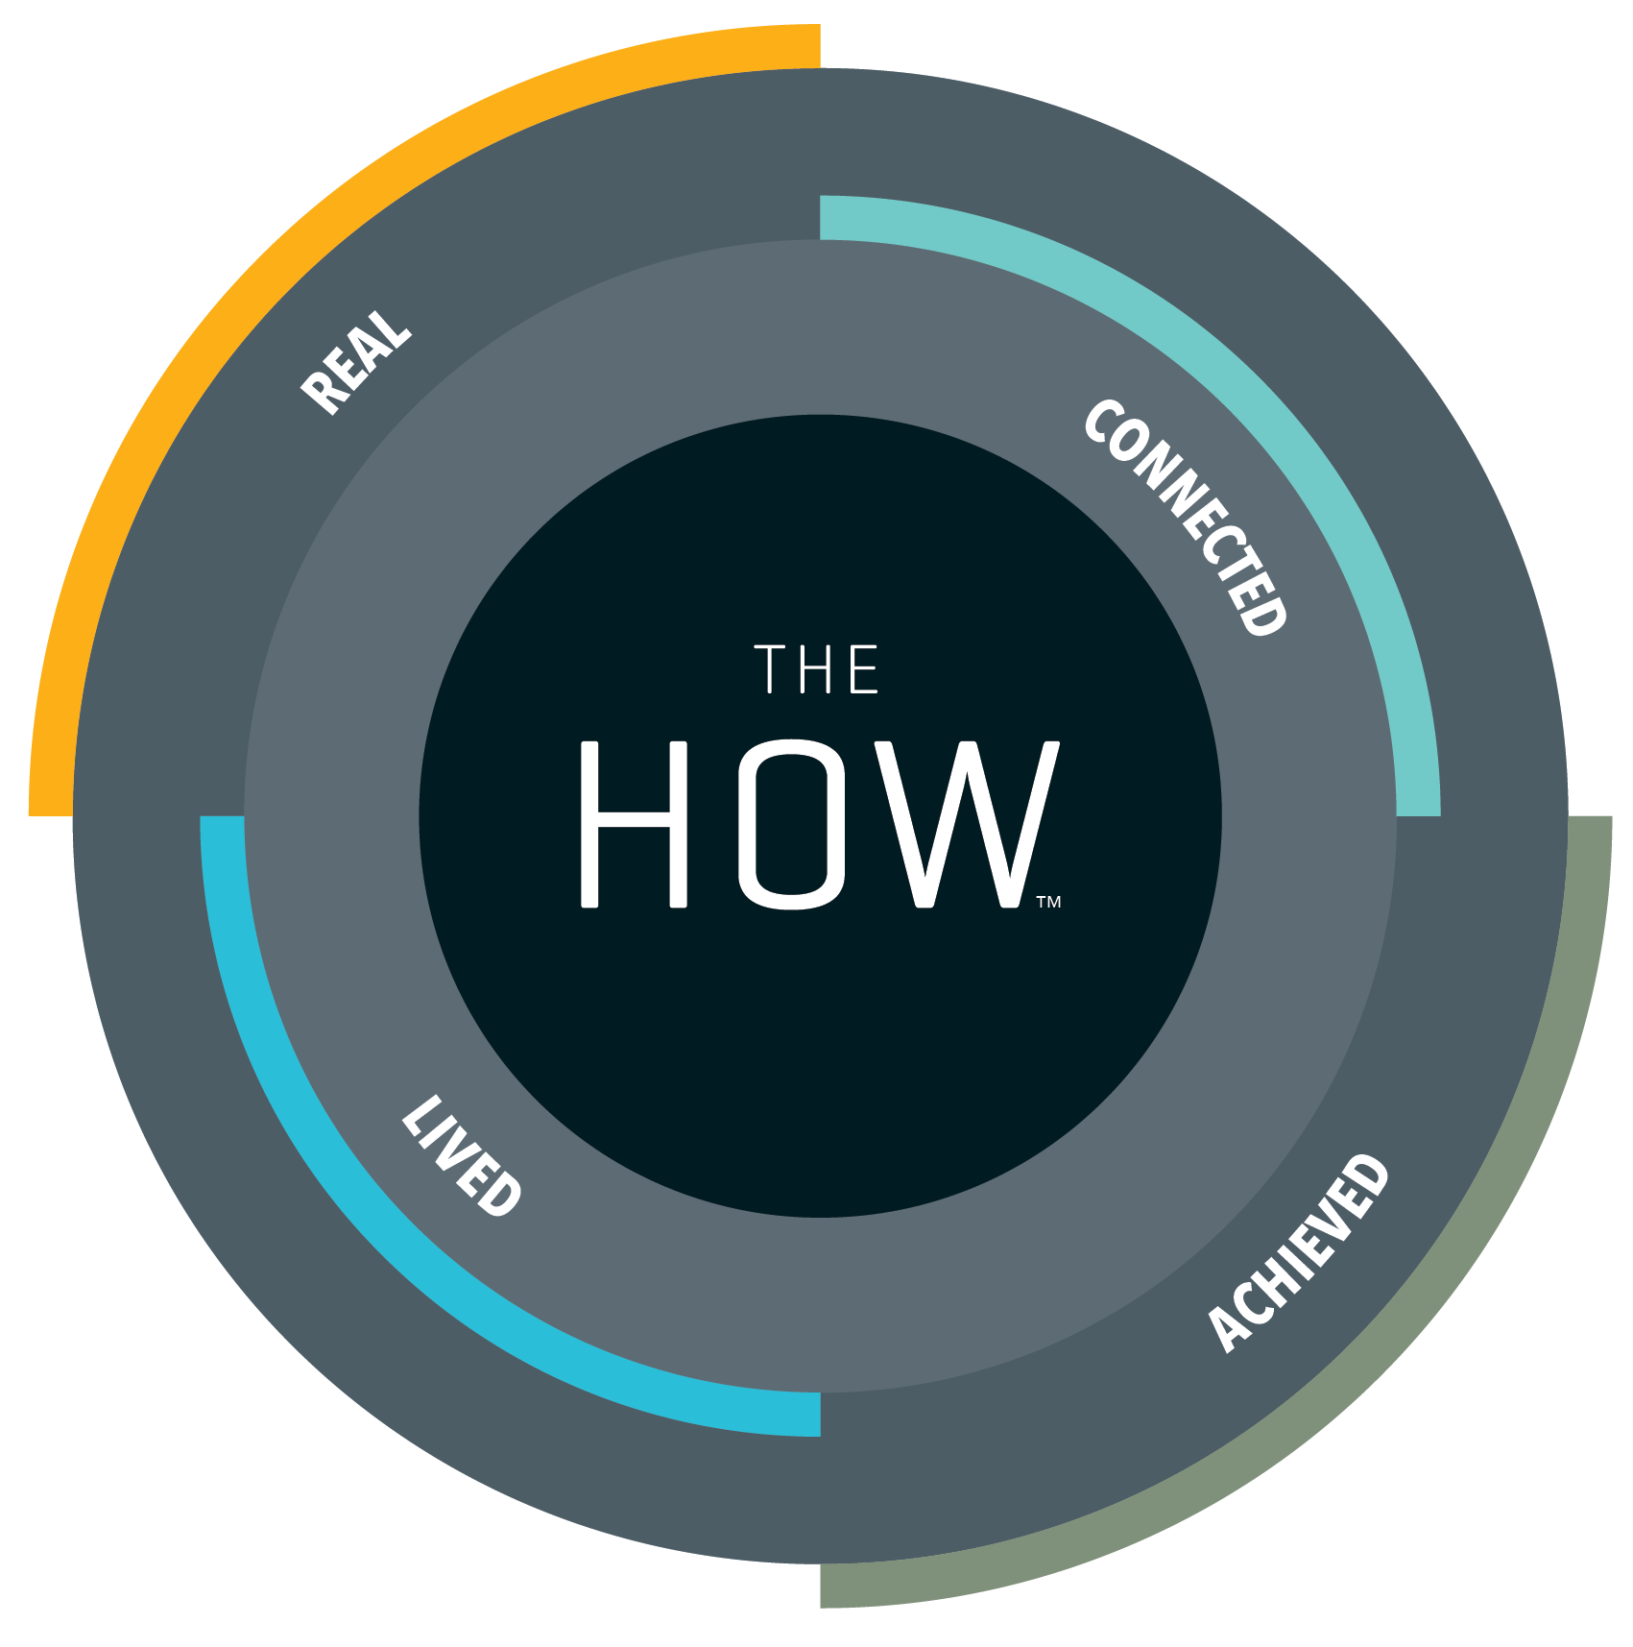
All our consultants are more than just the sum of our education and experience. We’re real people with real insight and real expertise.
STRATEGY
Our advisory services and solutions are strongly linked to your critical business objectives. Your strategic needs always form the basis for our bespoke approach, which is founded in proven methods and selective partnerships.
We know that transformations are about conscious leadership and engaging people, which require sustainable solutions and a trusted advisory partner.
We do not merely want to solve the present challenge,
we want to leave joint footprints with you. Our focus is on results – both yours and ours.
OPERATIONS

Slide 5
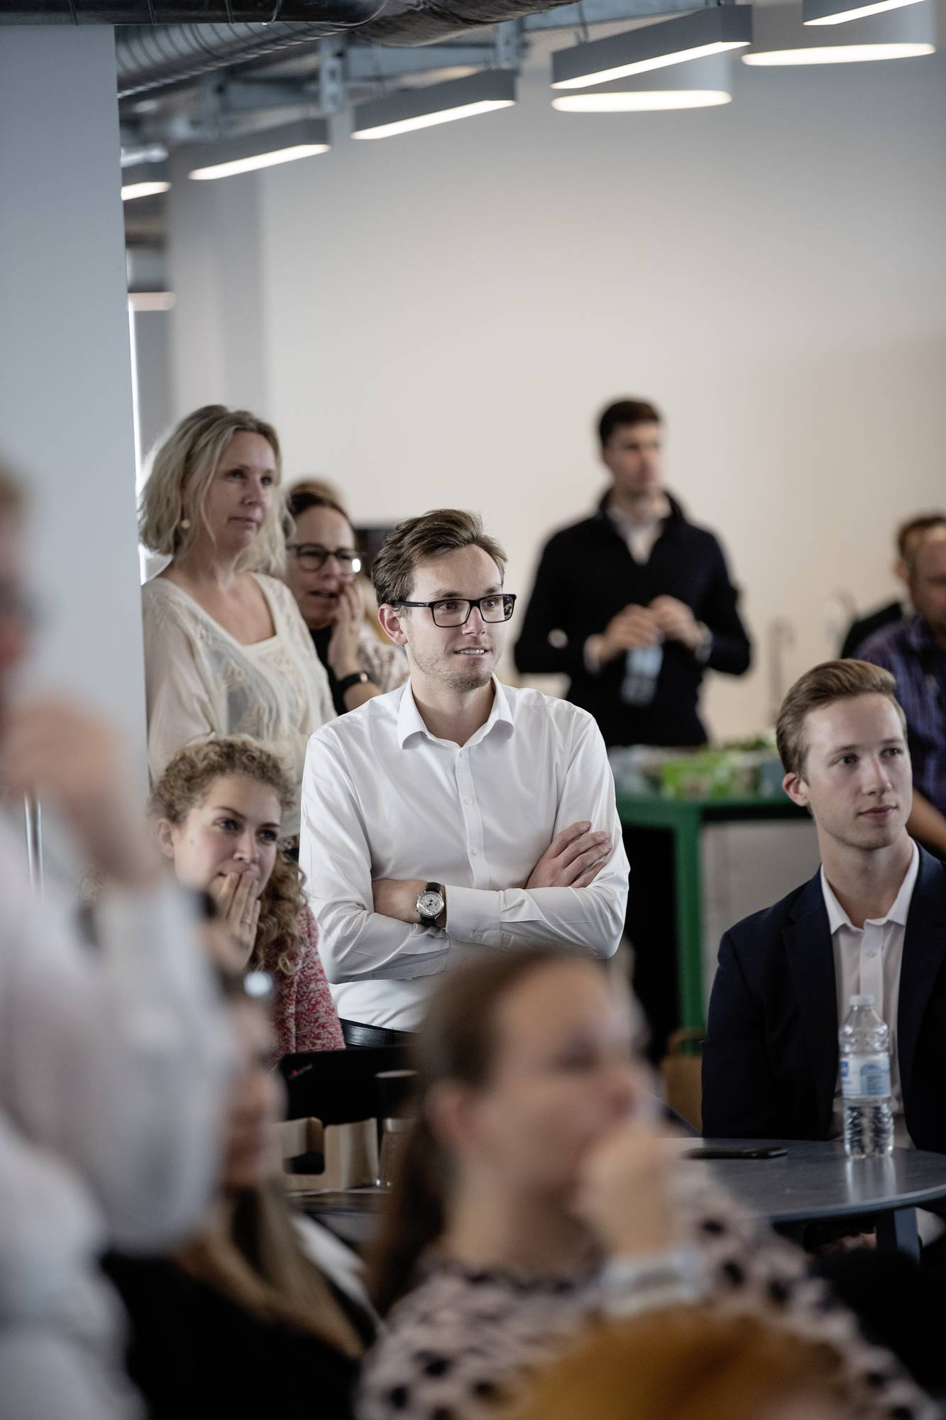
We are …
People who come with both consulting and industry leader experience but never with arrogance
People move people, not just systems. We are trained masters in the best change leadership framework in the world
A diverse and yet balanced team of brilliant and happy people with empathy and strong values
People who have held c-suite positions and understand the challenges from your perspective

Slide 6
We are …
People who come with both consulting and industry leader experience but never with arrogance
A diverse and yet balanced team of brilliant and happy people with empathy and strong values
People move people, not just systems. We are trained masters in the best change leadership framework in the world
People who have held c-suite positions and understand the challenges from your perspective

Slide 7
OPTIONAL
We are …
People who come with both consulting and industry leader experience but never with arrogance
People who have held c-suite positions and understand the challenges from your perspective
People move people, not just systems. We are trained masters in the best change leadership framework in the world
A diverse and yet balanced team of brilliant and happy people with empathy and strong values

Slide 8
We are …
OPTIONAL
People who come with both consulting and industry leader experience but never with arrogance
People move people, not just systems. We are trained masters in the best change leadership framework in the world
A diverse and yet balanced team of brilliant and happy people with empathy and strong values
People who have held c-suite positions and understand the challenges from your perspective

Slide 9
OPTIONAL
We are …
People who come with both consulting and industry leader experience but never with arrogance
People move people, not just systems. We are trained masters in the best change leadership framework in the world
A diverse and yet balanced team of brilliant and happy people with empathy and strong values
People who have held c-suite positions and understand the challenges from your perspective

Slide 10
We are …
OPTIONAL
People who come with both consulting and industry leader experience but never with arrogance
People move people, not just systems. We are trained masters in the best change leadership framework in the world
A diverse and yet balanced team of brilliant and happy people with empathy and strong values
People who have held c-suite positions and understand the challenges from your perspective

Slide 11
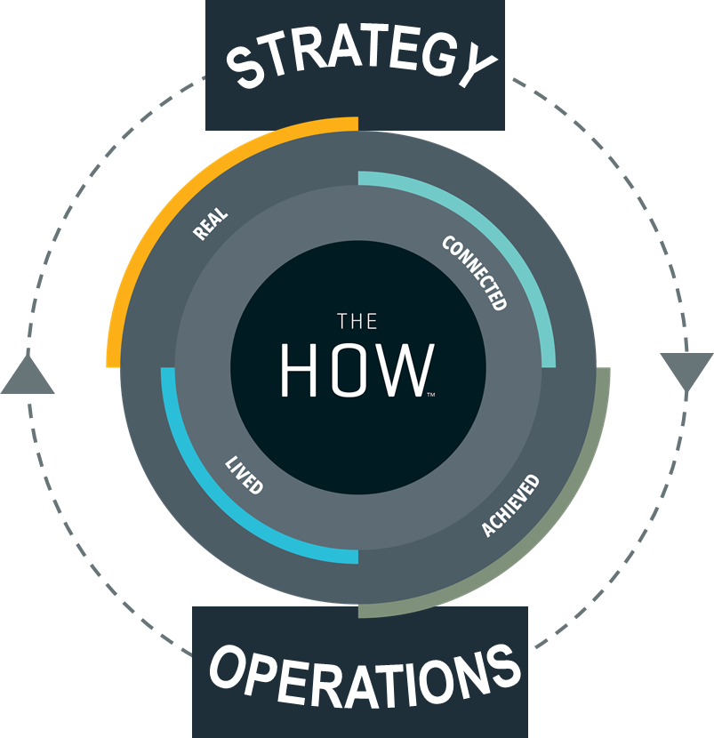


this is Valcon
The premium operations consulting Firm in Europe
se CBS – ud og ligge under Slides i Templafy
  ESTABLISHED IN 2000
  NATIONALITIES +10
  FOOTPRINTS IN 38 COUNTRIES
  We are HOW consultants who
  connect strategy and operations
  and we have the results to prove it
  “We aim to create a lasting impact for our clients – we call it leaving footprints”
Notes:
We are pre…

Slide 12





































examples of clients worldwide
Tjek op – tjek især Folke med Ulrika
INDUSTRY
PHARMA
PRIVATE EQUITY
PUBLIC
SERVICE
TRANSPORTATION
Notes:
Alle navne på de forskellige referencer i landene

Slide 13
examples of clients in europe
AVIATION
MED-TECH
TECHNOLOGY
CONSTRUCTION
AUTOMOTIVE
INFRASTRUCTURE
ELECTRONICS
PHARMA
CONSUMER GOODS
Notes:
Europe map

Slide 14
examples of public clients in Denmark
FREDERIKSHAVN MUNICIPALITY
VIBORG MUNICIPALITY
AARHUS MUNICIPALITY
HERNING MUNICIPALITY
HELSINGØR MUNICIPALITY
HOLBÆK MUNICIPALITY
ODENSE MUNICIPALITY
CITY OF COPENHAGEN
ESBJERG MUNICIPALITY
NÆSTVED MUNICIPALITY
SVENDBORG MUNICIPALITY
STEVNS MUNICIPALITY

Slide 15
examples of public clients in sweden
FREDERIKSHAVN MUNICIPALITY
VIBORG MUNICIPALITY
AARHUS MUNICIPALITY
HERNING MUNICIPALITY
HELSINGØR MUNICIPALITY
HOLBÆK MUNICIPALITY
ODENSE MUNICIPALITY
CITY OF COPENHAGEN
ESBJERG MUNICIPALITY
NÆSTVED MUNICIPALITY
SVENDBORG MUNICIPALITY
STEVNS MUNICIPALITY

